Slide 1
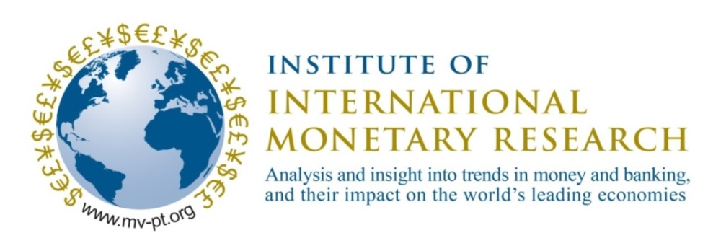
The saga of US public debt and inflation: and possible implications for the price of gold
A presentation by Professor Tim Congdon CBE,
Chair of the Institute of International Monetary Research,
in June 2025

Slide 2
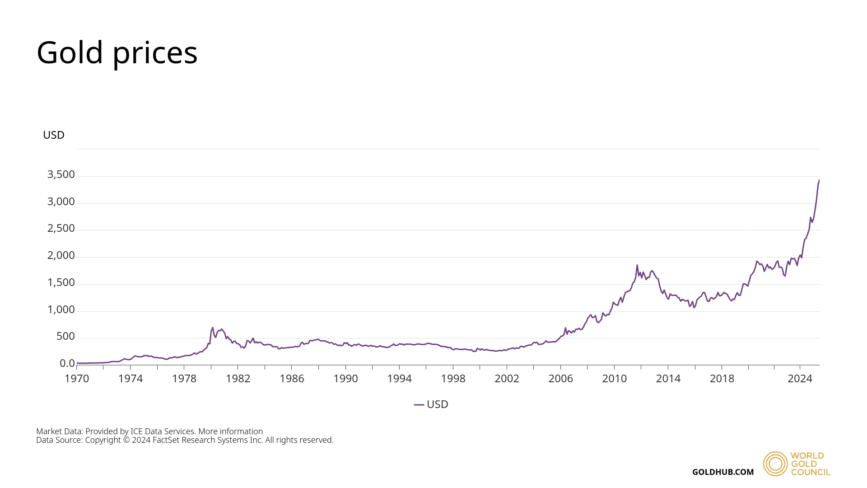
Between 1971 and 2025 the dollar price of gold per ounce has risen almost 100 times, from $35 to roughly $3,400. The compound annual rate of increase in that period has been 8.9%, much higher than the typical return on dollar-denominated bonds.

Slide 3
Public finances and inflation: a morality tale 1.
Suppose a nation has a budget deficit and public debt, and a weak-willed government with a soft, corrupt and feeble public elite.
The budget deficit adds to the public debt.
The extra public debt implies more debt interest.
Extra debt interest widens the budget deficit, which adds to the public debt, which implies more debt interest…
In the extreme the growth of the debt interest takes on a life of its own, as if it were a Frankenstein monster. Accountability for the debt explosion no longer seems to lie with the government of the day…

Slide 4
Public finances and inflation: a morality tale 2.
The seemingly uncontrollable growth of the public debt alienates potential investors, both at home and abroad.
In particular, foreign investors stop buying the nation’s government debt and may indeed become net sellers.
The government can finance its debt only from domestic sources, i.e., domestic non-banks and the domestic banking system. (The domestic banking system consists of the profit-seeking commercial banks and the central bank.)
As the debt-to-GDP ratio increases, domestic private-sector non-banks – i.e., households and savings institutions – become reluctant to raise the ratio of public debt to their own assets. They may even want to lower it.

Slide 5
Public finances and inflation: a morality tale 3.
If a government has no financial credibility in international markets and its debt cannot be sold there, if the non-bank private-sector domestic non-banks want to reduce the ratio of public debt to their own assets, and if the ratio of public debt to GDP is nevertheless still rising, the government will be forced to borrow heavily from the domestic banking system.
Excessive government borrowing from the domestic banking system risks rapid growth of the quantity of money, and rising inflation.
Rising inflation pushes up nominal interest rates – and hence interest costs on the public debt. This adds another spin to the crazy whirligig of an ever-increasing public debt and debt interest. Moreover, rising inflation reduces the real return on bank deposits, causing the ratio of money to GDP to decline.

Slide 6
Public finances and inflation: a morality tale 4.
The inter-related explosion of public debt and runaway inflation are such that now the government has no credibility with foreign investors and domestic private-sector non-banks, while the heavily regulated commercial banking system is shrinking relative to GDP.
The only remaining source of finance for the government is the central bank, which issues more monetary base or so-called “high-powered money”. The monetary base includes banks’ cash reserves and is the base of the so-called “credit pyramid”.
The government borrows heavily from the central bank, which “prints money” and adds to banks’ cash reserves, motivating very rapid increases in high-powered money and the quantity of money, and inflation accelerates…potentially without limit.

Slide 7
Public finances and inflation: a morality tale 5.
Inflation can take different forms,
Moderate roughly on-target inflation of about 2% a year,
Galloping inflation, defined in various ways, with range of 10% - 100% a year sometimes given, or over 2% a month, and
Hyperinflation, with prices rising by over 50% a month.
At the end of a hyperinflation, some wealth-holders will be left unscathed. Gold has the vital merit that its stock changes very slowly, and its real value at the beginning and end of a hyperinflation are likely to be much the same. So gold acts to protect savers from inflation – and the mismanagement of the public finances, which historically has been rife in some nations (esp. in Latin America, but also in Weimar Germany, post-WWII Eastern Europe, Mugabe’s Zimbabwe…)

Slide 8
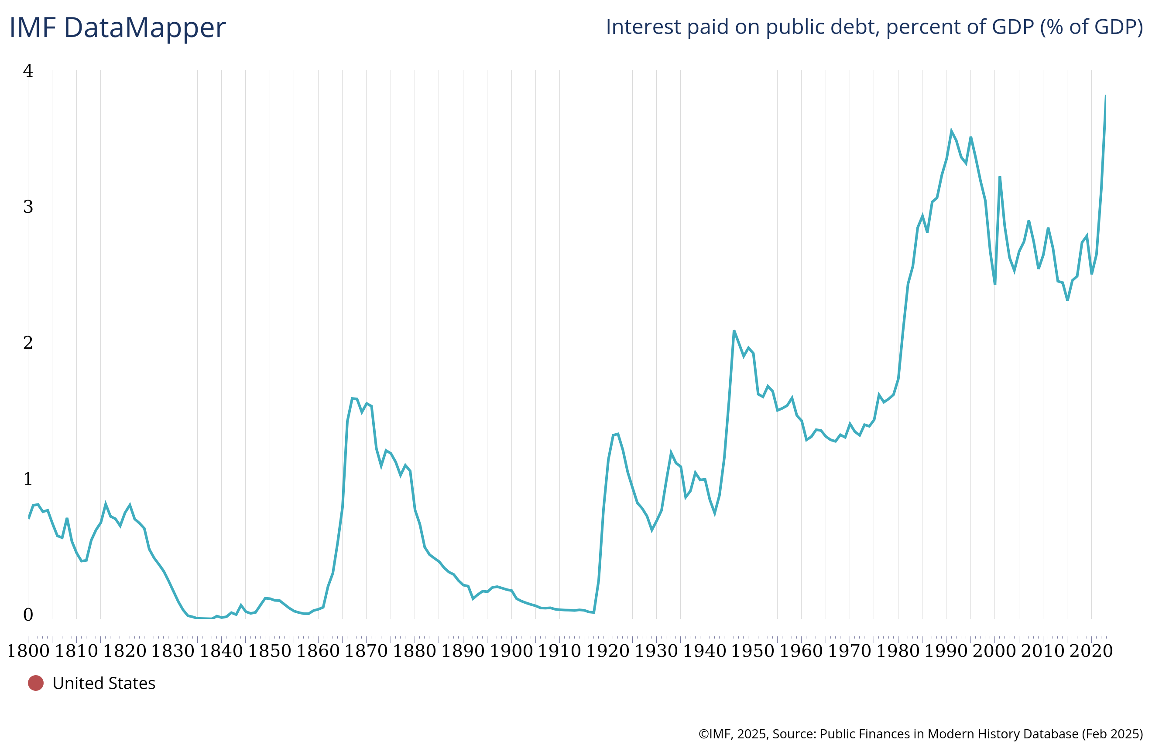
Interest paid on US public debt, as % of GDP, 1800 – 2023

Slide 9
Notice that the peak coincides roughly with Xi Jinping’s assumption of China’s Presidency and first Russian invasion of Ukraine.

Slide 10
The cost of the ‘big, beautiful bill’
The Republican-sponsored budget bill now before the Senate in the US Congress is forecast to add $600b. a year to the Federal budget deficit.
But the enlarged deficit adds to the debt, which adds to the debt interest…
In the accompanying chart, the higher blue line for the late 2020s shows the likely effect of the bill – called by President Trump both ‘big’ and ‘beautiful’ – on the debt.
According to the IMF in its April ‘World Economic Outlook’, the ratio of public debt to GDP was headed for 128.2% of GDP in 2030. If the ‘big, beautiful bill’ passes Congress, the right figure to have in mind for 2030 might instead be over 138% of GDP.

Slide 11
Projections are to the right of the dotted line.

Slide 13
The latest news on the US Federal deficit
In the year to May 2025 the US Federal deficit was $1,990.3b.
In the year to May 2024 it was $1,732.5b.
So the deficit has increased – comparing recent years – by $257.8b.
In this sense the US public debt position is still deteriorating, despite the efforts of Elon Musk in the opening months of the 2nd Trump administration to control public spending and the deficit.
Musk has now left the Trump administration – and complained that the budget bill is a “disgusting abomination”.

