Slide 1

Money and the State:
what is the best relationship between
the monetary regime and government?
A presentation by Professor Tim Congdon CBE,
Chair of the Institute of International Monetary Research,
in August/September 2025

Slide 2
Lack of agreement among free-market liberals on the state and the monetary regime: Friedman and Hayek at opposite extremes
Hayek’s advocacy late in his career of the abolition of legal tender laws, ‘denationalization of money’ and ‘choice in currency’, i.e., the state to have no role in his favoured monetary regime. Instead all money is to be issued by the private sector, with the private-sector suppliers to compete.
Friedman at various stages in his career supported the 100% cash reserve banking system proposed by, for example, Irving Fisher in the 1930s, with banks’ demand deposits (or sometimes even all deposits) to be matched 100% by cash issued by the central bank. The aim was to end the creation of money by the privately-owned commercial banking system (when it made loans or bought securities). Money is to be 100% backed by the state.

Slide 3
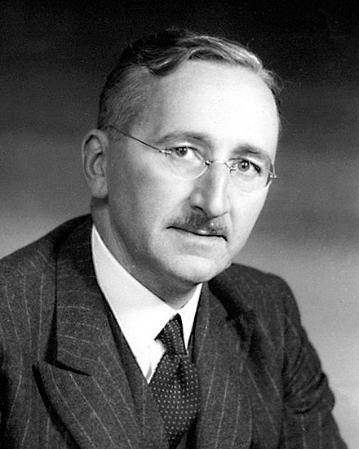
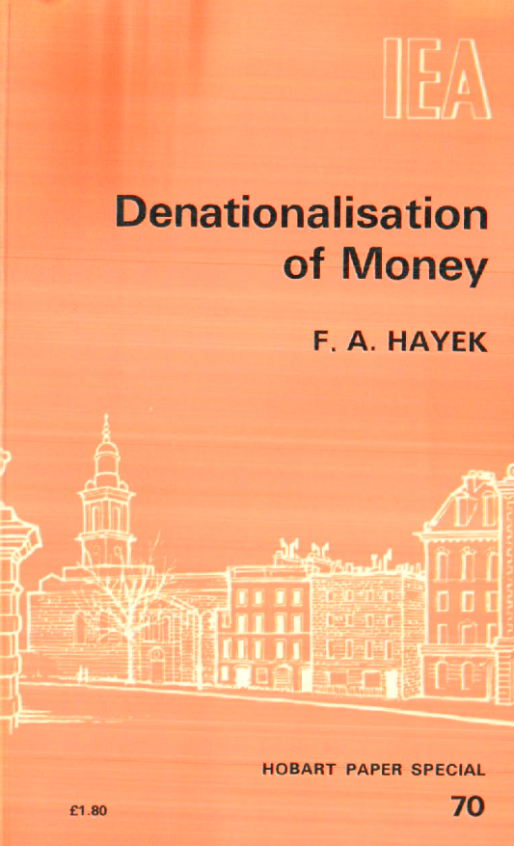
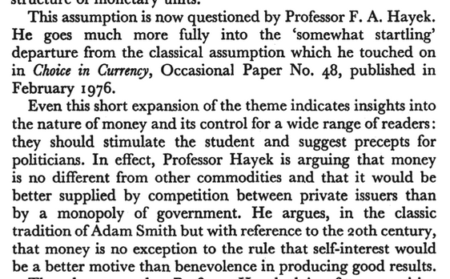
Hayek and ‘choice in currency’, 1976, followed by more detailed argument in a 1978 pamphlet from the London-based think tank, the Institute of Economic Affairs
Text by Arthur Seldon, in summary of Hayek’s argument

Slide 4
Hayek and ‘choice in currency’, 1976, followed by more detailed argument in a 1978 pamphlet from the London-based think tank, the Institute of Economic Affairs
Many claims have been made that Hayek’s proposal anticipated crypto-currencies, which are often said to be competing private-sector ‘monies’.
“Although there are historical examples of privately issued banknotes denominated in the national currency, Hayek envisaged something more radical. He propagated a competition of currencies, that is, a competition of “different kinds of money clearly distinguishable by different denominations among which the public could choose freely” (Hayek 1978, p. 27).
“For decades, Hayek’s proposal received little academic, political, or economic attention. However, with the creation of the entire cryptocurrency universe in the 2010s, currency competition has become a reality.”
- From a 2024 paper from Mayer and Bofinger

Slide 5

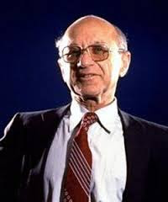
Friedman and the 100% cash reserve proposal
Friedman’s most detailed proposals for a monetary regime were in his 1959 Millar lectures in New York, although he made many such statements - and they varied.
The Millar lectures did refer to the 100% cash reserve idea, but with less prominence than a 1948 paper on the framework of monetary and fiscal policy (which in effect Friedman came to repudiate).
1983 printing of a 1960 book based on the 1959 Millar lectures at Fordham University in New York.

Slide 6
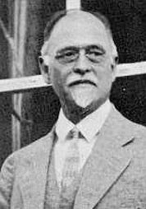
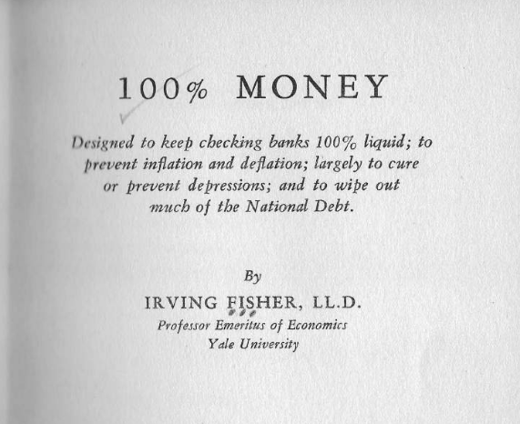
Friedman blessed, but did not originate, the 100% cash reserve proposal
Irving Fisher wrote a book on 100% Money in 1935, published by the Adelphi Press in New York.

Slide 7
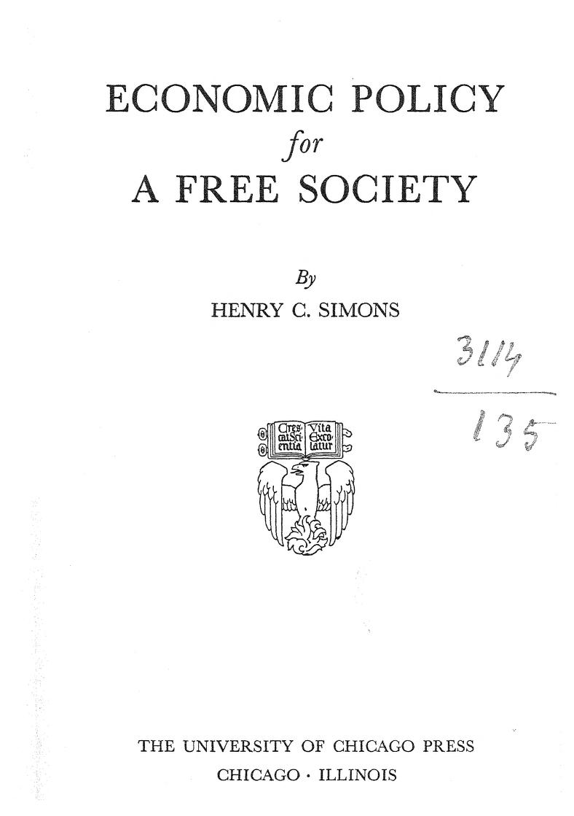

Friedman blessed, but did not originate, the 100% cash reserve proposal
But the 100% cash requirement is hugely interventionist…!
The 1948 book Economic Policy for a Free Society contained material from Simons’ 1934 A Positive Program for Laissez-Faire, including the 100% cash reserve proposal.
Henry Simons (1889 – 1946) was one of Friedman’s teachers at the University of Chicago in the early 1930s.

Slide 8
Irving Fisher tried to persuade Keynes of the virtues of the 100% cash reserve idea, but Keynes wasn’t interested. But Keynes did not see the plan as viable practically or politically. The banking industry was opposed. Indeed, it was
100% opposed.

Slide 9
The radicalism of the alternative answers from Hayek and Friedman (and indeed the Chicago School more generally, and Irving Fisher)
Free-market liberalism lacks a consensus in this central area of economics, but notice the radicalism of the answers discussed so far. Hayek wanted to scrap legal tender laws, and to end altogether state involvement in money creation and monetary policy; Friedman – whose contributions to the subject fluctuated and might even be described as volatile – mostly went along with the position (taken by Irving Fisher and Henry Simons in the 1930s) that huge fluctuations in bank lending to the private sector, and the consequent movements in the quantity of money, were pernicious in their wider economic effects. In this sense they all blamed the Great Depression on the private creation of money. So they wanted the state to dominate money creation and monetary policy.
The only shared aspect of their very different treatments of the subject was extreme radicalism, perhaps rooted in Hayek’s case in a commitment to freedom as an ultimate value. (In my view, it is difficult to say the same thing about Simons, Fisher, Friedman and the Chicago School, but they thought they were defending the market economy.)

Slide 10
The radicalism of the alternative answers from Hayek and Friedman (and indeed the Chicago School more generally, and Irving Fisher)
All these thinkers declined to defend the status quo, the main features of which will be described shortly. In practice, the provision of money in a modern economy involves both the state and the private sector. In other words, the economists just discussed were in this area of economics not conservative at all. (Hayek of course denied being a conservative, while Friedman saw himself as a classical liberal in the 19th century sense.)
I will now describe the status quo and attempt to provide a rationale for it. In doing so, I will be unashamedly a defender of the existing order, not an advocate of change and upheaval. Money and banking develop over time, and the processes can – in my view – be understood as organic and evolutionary. Despite the occasional importance of legislation, the status quo can even be seen – if controversially – as a spontaneous order.

Slide 11
The current monetary system: the state, the central bank and commercial banks
In the current system of relations between the state and the banking system, the central bank has four characteristics,
- It possesses the monopoly right to issue legal-tender money, which – in a fiat-money world – has no intrinsic value,
- It is mandated by the state to keep the real value of that money fairly stable, despite the lack of intrinsic value,
- It provides banking services* to only the government and the banking system, and not to non-banks, and
It is separate from a competitive and profit-oriented commercial banking system, which has mostly non-bank customers, and is fractionally-reserved and highly leveraged.

Slide 12
The current monetary system: the state, the central bank and commercial banks
*
In my view, which is again controversial, the central bank should be Bagehot-ian, not Ricardian. That is, it should accept and publicly recognise a responsibility to ensure that solvent banks complying with regulations can borrow freely from it (and/or sell securities to it for cash). In other words, the central bank has a lender-of-last-resort role. This is a service it provides to commercial banks in the interests of wider economic efficiency.
…………………
The central bank – the dominant issuer of legal-tender cash – is separate from the commercial banking system, which settles debts between its members in that cash. The central bank does not have a profit objective. By contrast, the commercial banking system is usually owned by the private sector and is a profit seeker.

Slide 13
In the rest of this presentation, I distinguish between liberalism (where a government monopolizes the means of coercion, and protects the freedom of individuals and their property under the law) and anarchism (where, ideally, societies…somehow… exist without government at all). (I know Friedman was not an anarchist; I am pretty sure Hayek – the author of The Constitution of Liberty – was not one either, but don’t have chapter and verse.)

Slide 14
So we are talking about societies/nations which have governments, and where governments have finances, i.e., tax revenues plus the more general powers of the fisc, as well as expenditures. As the government has finances, it also – in modern circumstances – has relations with the banking system, and it makes sense to talk of ‘the government’s bank’ (or perhaps the government’s banks in the plural – another discussion point).

Slide 15
I. Answer to Hayek
Competition is not always the correct organizational structure.
We don’t want competition between different ‘governments’ (all with weapons) in one nation state, because the result is chaos – gangsterism (Haiti today), warlord-ism (China in the inter-war period) or outright civil war (as in Sudan at present). (Read such classics as Hobbes’ Leviathan or Nozick’s Anarchy, State and Utopia.)
We don’t want competition in parenthood. Children have their natural parents, who care for their own offspring much better in stable and loving partnerships (marriages, mostly) than in alternative competitive arrangements where natural parents have no right to look after their own children.

Slide 16
I. Answer to Hayek
Competition is not always the correct organizational structure.
Even in more strictly economic organization, competition – with the price mechanism between suppliers to ultimate consumers, and contracting, sub-contracting and input pricing in production – is not always the best approach.
- Coase’s distinction between the price mechanism and the fiat mechanism, and the resulting rationale for the existence of vertically-integrated firms in which the fiat mechanism dominates, instead of contracting and sub-contracting with the price mechanism, and
- Niall Ferguson’s related distinction between networks (which are ‘horizontal’ and use the price mechanism) and hierarchies (which are ‘vertical’ and use the fiat mechanism). See Ferguson’s 2017 The Square and the Tower.

Slide 17
I. Answer to Hayek
Competition is not always the correct organizational structure.
In the case of money, it is rather obvious that competition is not the answer. We use money to reduce search and transactions costs. We then favour a single standard of value and one medium of exchange, precisely because their singleness reduces search and transactions costs!
Do we want to see prices in several different currency units?
Do shops want to set prices in several different currency units (dollars, Bitcoin, Ethereum, etc.), checking exchange rates between them every day or even every few hours? Consider the problem for retailers if – at the end of every day – they have to total values of coins and notes in a multiplicity of units...
Do people want multiple bank statements, again in different currency units?
A money is adopted in a particular country precisely because there is only one such money!

Slide 18
I. Answer to Hayek
Competition is not always the correct organizational structure.
In the case of money, another problem relates to notes and – even more – to scriptural money in the form of bank deposits. Notes – unlike gold – have no intrinsic value and negligible production cost. The difference between their nominal value and intrinsic value may be large, in which case the question arises of ‘to whom does that value belong?’. Does it belong to the banker issuing the notes? – given that the banker may convert the value into gold (or whatever) and then ‘run’/emigrate/disappear.
No time now to discuss cryptocurrencies – but it is clear that fraud and ‘running’ do happen on a significant scale.
Money issuance – and issuance of crypto-currencies – should not benefit fraudsters.

Slide 19
II. Answer to Friedman
Banking begins with the realization that deposits do not have to be 100% covered by cash. Fractional-reserving and high leverage inside banking industry reduce cost of bank finance, and hence are socially beneficial. Sure, that leads to more risk. Bankers – and the societies in which they operate – need to manage the benefits of banking against the potential costs. 100% cash reserve banking is not banking at all, but an extreme retrogression to a pre-banking world.
Consider the challenges and opportunities facing a goldsmith in a pre-banking world…Part of my MSc course at the University of Buckingham.

Slide 20

Evolution of goldsmiths into bankers: the beginnings
A goldsmith owns some
gold, available for making
into jewellery. The goldsmith
has no plans at this stage
to become a banker.

Slide 21
Goldsmith’s ‘capital’ is of course his or her equity investment in the business, on which a rate of return is sought.

Slide 22
This is in fact 100% cash reserve banking, with the receipts/‘notes’ being for deposits of gold.

Slide 24
This is no longer 100% cash reserve banking, with banks’ assets now including loans repayable in gold as well as gold itself.

Slide 25
Notice reference to ‘the law’, and so to a law-maker and law-enforcer, i.e., the state and a government.

Slide 26
Notes replace gold in payments, with lower transactions costs

Slide 27
Banking profitable & ‘goldsmith banker’ offers interest on deposits

Slide 28
Embryonic banking becoming true banking 3. – The Eureka moment!
Notes of better-established issuers come to be regarded “as good as gold”. Their reputation may be strengthened by the state, e.g., if issuing bank has a monopoly of banking by law in a certain area.
Loans can be made in notes, not gold. The Eureka moment! The fundamental watershed. Banking proper begins.

Slide 29
Embryonic banking becoming true banking
Notes unbacked by gold, but redeemable into gold, approaching half of liabilities.
Interest-bearing loan assets approaching size of gold held in vaults and tills.
Assets must be safe, so that depositors can always be repaid in full. But safety of assets reduces return per unit of assets and depresses profits.
Capital is therefore reduced as share of liabilities, in order to boost return on capital, which depends on average loan spread % and capital/asset ratio %. Banks are inherently highly-leveraged.

Slide 34
Banking develops, and so do the economies it serves…
Money-lenders in, say, modern Somalia or Ethiopia
Spreads on loan to prime corporate borrowers (and sovereigns) in the London Eurocurrency offshore banking markets in the 1980s.

Slide 37
We are talking about societies /nations with a government; we are ‘liberals’, just like Hayek and Friedman, not anarchists!

Slide 40
Yes, we have advocates of the gold standard – and 100% cash reserve banking – and the early 21st century!!

Slide 42
The present system – and the historical background to its main features
Central banks’ monopoly of legal-tender note issue.
Central bank responsibility to maintain real value of its legal-tender liabilities.
Central bank is banker only to government and banking system, not to non-banks.
Nations want only one money, with certainty about its nominal value.
Central bank controls supply function of base money, but it is not a profit-maximiser.
Separation of central bank from commercial banks leaves profit-maximisation to commercial banks. (And competition drives down cost of banks’ services.)

Slide 43
The present system – and the historical background to its main features
Central bank provides lender-of-last-resort services, if at high cost and only to solvent banks.
Profits from note issue belong to central bank in first instance, but these are passed to government.
Legislation on central bank gives it right to issue paper liabilities without commodity backing.
Banks – subject to runs – need a safe reserve bank, which ideally can issue ‘cash’ (‘gold’), and the safest bank is banker to the government.
Wrong for private-sector money issuers – perhaps fraudulent – to earn profits from note issuance, which properly belong to state.
Creation of money by ‘stroke of the pen’ (or computer key) saves on resources relative to commodity money.

Slide 44
II. Answer to Friedman
100% cash reserve banking would hugely increase the cost of banking services to the non-bank individuals and companies, who are the banks’ customers. Banks would in fact become little more than custodians and would cease to be “banks”, as they are now understood.
One specific type of banking product, the overdraft, could not be extended by banks. Overdrafts depend on banks’ ability to extend their balance sheets without previously taking in deposits; they depend – in other words – on the discovery that came with (what I have called) “the Eureka moment”.
In fact, in its most extreme form, 100% cash reserve banking would prevent the banks having any interest-paying assets at all. Friedman was in fact in favour of the payment of interest on banks’ cash reserves, but he never said what assets the central bank was meant to hold so that it could pay such interest. He was indeed unconcerned to integrate the determination of banks’ rate of return on capital/equity into his analyses.

Slide 45
II. Answer to Friedman
Friedman wrote a book – sometimes presented as being co-authored with his wife, Rose – called Free to Choose. It defended the free market against government interference of all kinds. But Friedman’s views on banking were plainly very interventionist. Instead of leaving banks free to choose their cash and capital ratios, subject to various constraints, he – like other members of the Chicago School and Irving Fisher – would impose such severe restrictions on banks that they could barely exist. (Compare this with the prohibitions on the payment of interest in pre-modern Christian and Islamic societies, and with – for example – prohibitions on gambling in Islam.)
Unbelievably, Friedman never showed the slightest awareness that 100% cash reserve banking would be illiberal (as well as – in my view – economically very inefficient).

Slide 46
Concluding notes on some characteristics of the argument(s) just presented
The argument(s) of this presentation have been clearly conservative, in that it/they defend the status quo. I regard this as a merit. The status quo is found in nearly all the world’s countries, if with variations (such as currency-board nations and the still experimental Eurozone currency union). No nation has competition between widely-used monies or 100% cash-reserve banking.
The argument has been that currency provision and banking evolve from goldsmith banking (or equivalents) to the modern arrangements, with a separation of central banking from commercial banks, which are – inherently – both fractionally-reserved and highly-leveraged.

Slide 47
Final comments, as a sort of addendum 1.
Should a nation have a few competing central banks, as favoured – for example – by Bagehot?
No, because – if the central banks are privately-owned – the allocation of government business between them would affect profitability – and the most favoured bank or banks would then be criticized because they had received political favours…
(This sort of question was important in the pre-Federal Reserve USA, with ample historical evidence to demonstrate the point.)

Slide 48
Final comments, as a sort of addendum 2.
Should the central bank be owned by the state or the private sector?
The profits from the note issue ought – in a fiat-money world – to accrue to the state. The conduct of monetary policy – to keep the value of legal-tender notes stable in real terms – is a matter of public policy. These considerations argue for a state-owned central bank.
But the lender-of-last-resort function of the central bank – which results in profits and losses – could be performed by a privately-owned body or a public-private partnership. The capital could come from members of the banking system’s settlement infrastructure, i.e., in practice all the large commercial banks. Any shortfalls in its capital – because of bad loans to failing banks – would have to be made good by these commercial banks. (The allegation – from, for example, the Financial Times’ Martin Wolf – that banks ‘socialize losses and privatize profits’ would be without substance.)

Slide 49
Concluding notes on some characteristics of the argument(s) just presented
Could it even be claimed that the pattern of evolution described is ‘a product of human action, but not of human design’? Could it be seen as the kind of ‘spontaneous order’ so much admired by Hayek? (By contrast, his recommendation – never seen until the advent of crypto-currencies – could be labelled ‘Trotskyist’, in that it seems to foreshadow endless uncertainty about the best ‘money’ and hence permanent revolution in monetary affairs.)
Admittedly, in many nations central banks began in wartime conditions to help finance the government – and were established by government.
- Debate and discuss – this is all very controversial.

