Slide 1

A new “monetary-fiscal settlement”?: the case for a balanced budget rule
A presentation by Professor Tim Congdon CBE,
Chair of the Institute of International Monetary Research,
in January 2026

Slide 2
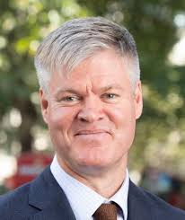
‘We need a new monetary-fiscal settlement’ – an article in the Financial Times,15 October 2025
Professor David Aikman - Director of the National Institute of Economic and Social Research
Aikman was worried about “large and unavoidable…spillovers between fiscal and monetary policy”. In his view, we needed “a formalised Treasury-Bank of England protocol”.

Slide 3
‘We need a new monetary-fiscal settlement’ – an article in the Financial Times,15 October 2025
Aikman’s final sentence ran, “But with debt-to-GDP at record highs, the longer-term challenge remains: without tackling that, the drift towards a situation where fiscal pressures dictate monetary policy – and, with it, higher inflation – will be hard to resist”.
Professor David Aikman - Director of the National Institute of Economic and Social Research

Slide 5
Loss of control over public debt, 2007 to today
Relative to gross domestic product, the net debt of the UK public sector (excluding state-owned banks) was
40.1% in 1981,
36.1% in 2007, and
94.8% in 2024

Slide 6
Between the late 1980s and the Great Recession debt interest was small and manageable.

Slide 8
Risk of further loss of control over public debt, today
Relative to gross domestic product, the net debt of the UK public sector (excluding state-owned banks) was
40.1% in 1981,
36.1% in 2007, and
94.8% in 2024
CLEARLY, IF INTEREST RATES TODAY WERE AT THE SAME LEVEL AS IN THE EARLY 1980s (i.e., IN DOUBLE DIGITS AND POSITIVE AT ABOVE 5% IN REAL TERMS), THE UK PUBLIC DEBT SITUATION TODAY WOULD BE TOTALLY UNSUSTAINABLE.

Slide 9
Risk of further loss of control over public debt, today
CLEARLY, IF INTEREST RATES TODAY WERE AT THE SAME LEVEL AS IN THE EARLY 1980s (i.e., IN DOUBLE DIGITS AND POSITIVE AT ABOVE 5% IN REAL TERMS), THE UK PUBLIC DEBT SITUATION TODAY WOULD BE TOTALLY UNSUSTAINABLE.
- Is that inconceivable? On 25 September 2025 Andy Burnham, the mayor of Greater Manchester and a possible Labour Party leader, told the New Statesman magazine: “We’ve got to get beyond this thing of being in hock to the bond market.” He suggested a pact was possible with the former Labour leader Jeremy Corbyn, who sits in parliament as an independent. OF COURSE, THIS SORT OF RHETORIC MAKES A BIG RISE IN GILT YIELDS MORE LIKELY.

Slide 10
TWO MAJOR TURNING-POINTS IN DEBT INTEREST BILL, IN 1981 AND 2011

Slide 11
1ST Turning point, in the early 1980s
In the late 1970s the UKK’s public debate on economic policy moved towards “monetarism”, including a commitment over the medium term (i.e., in 1980’s Medium-Term Financial Strategy) to reduce the budget deficit.
The 1981 Budget included large tax rises. The effect of this Budget, plus the lucky accident of rising taxes on North Sea oil profits, stopped the national debt growing faster than GDP. In the late 1980s the debt even fell in some years, and the ratio of debt to GDP fell sharply.
In 1988 Nigel Lawson announced a “balanced budget” rule in that year’s Budget…And this prevailed for the rest of the 1979 – 97 Conservative government.

Slide 12
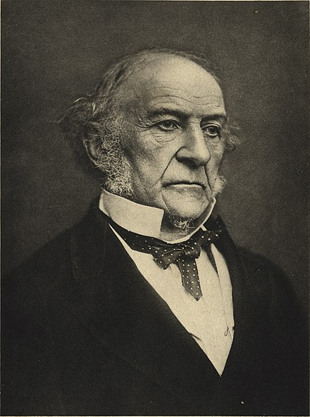
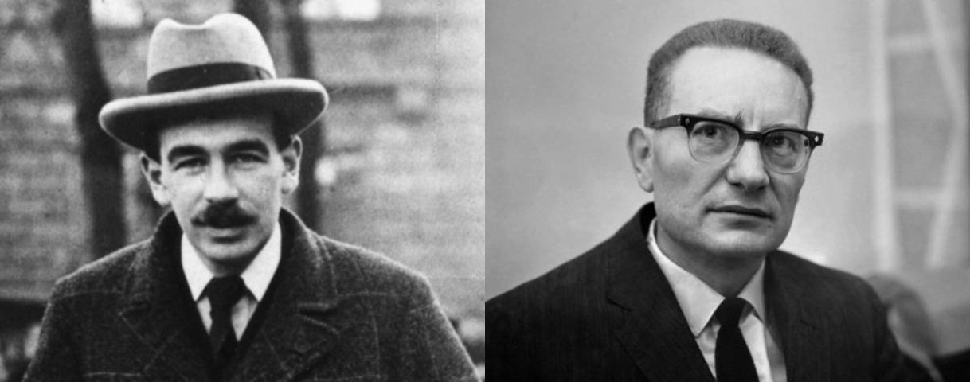
The key debate
‘Sound money’ represented here by William Gladstone.
Sound money
The Keynesian textbooks, especially Samuelson
Decisions on government finances should be determined by a ‘balanced budget rule’, to ensure medium-term fiscal solvency and, in particular, to limit the debt interest bill.
Decisions on government finances should be determined by the state of the economy, with increases in the deficit (‘to boost demand’) when output is beneath trend and unemployment is high, and reductions in the deficit when output is above trend…

Slide 13
Medium-term financial strategy
MTFS, and balanced budget rule

Slide 14
Debt always under 41% of GDP from 1980 to 1997
In the 1979 -97 Conservative period, the MTFS and then the balanced budget rule succeeded in bringing public debt under control…and also keeping it under control. Debt interest fell as a share of GDP from 5% in 1981 to under 3% in the early 1990s and 3½ % in 1997.
1979 – 97 Conservative government

Slide 15
Debt always under 41% of GDP from 1980 to 1997
This period involved an outright rejection of Keynesian fiscalism, i.e., the idea that aggregate demand should be managed by adjusting the budget balance ‘to inject demand when the economy was weak’ & ‘to withdraw it when demand was too strong’.
1979 – 97 Conservative government

Slide 16
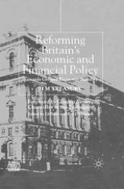
New Labour’s approach to the subject: a different ‘monetary-fiscal settlement’?
Gordon Brown Chancellor of the Exchequer, 1997 – 2007.
In 1997 and 1998 Gordon Brown’s associates at the Treasury – Ed Balls, the chief economic adviser, and Gus O’ Donnell, head of the Government Economic Service, devised apparently new rules, i.e., a ‘golden rule’ saying the current expenditure had to be matched or exceeded by current revenue, and a ‘sustainable investment rule’, that net debt would not exceed 40% of GDP. They even wrote a book together.
In fact, these rules merely continued the ‘balanced budget rule’ pursued by the Conservatives in the previous decade, but used different phrases.
The rules were respected, more or less, until 2007. But – with the Great Financial Crisis from mid-2007, and the Great Recession of 2008 and 2009 – they were abandoned.

Slide 17
Abandonment of fiscal rules by Gordon Brown in 2008 and 2009, on Keynesian grounds
Background to the 2009 Budget – Dated 9 April 2009, by Dominic Webb of the Treasury’s ‘Economic Policy and Statistics Section’
‘Unemployment has now passed the two million mark…[L]evels of government borrowing and debt were [last year] already high by historical standards…The [2009] Budget is also likely to set out whether the Treasury believes a further fiscal boost to the economy is needed…’

Slide 18
Abandonment of fiscal rules by Gordon Brown in 2008 and 2009, on Keynesian grounds
According to IMF data, the UK’s general government structural (i.e., cyclically-adjusted) deficit rose by 1.9% in 2008 and 1.5% in 2009.
An obvious contrast with the early 1980s, when this measure of the deficit was reduced sharply in order to meet the figures set out in the 1980 Medium-Term Financial Strategy. Brown’s decisions in his Premiership (2007 – 10) undermined medium-term fiscal solvency.

Slide 19
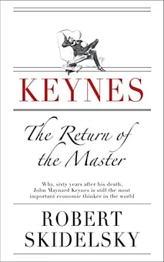
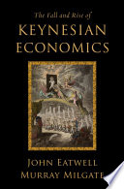
The return to Keynesian fiscalism
Skidelsky’s The Return of the Master published in 2009; Eatwell and Millgate’s The Fall and Rise of Keynesian Economics in 2011.

Slide 20
2ND Turning point, in 2010 and 2011
In 2010 and 2011 the newly-elected Conservative-LibDem Coalition government confronted the surge in debt interest costs.
George Osborne, Chancellor of the Exchequer 2010-16, organized a meeting to seek the advice of the still living former Chancellors of the Exchequer from the 1979 – 97 Conservative government, i.e., Geoffrey Howe, Nigel Lawson, John Major, Norman Lamont and Kenneth Clarke. They all recommended action to curb the budget deficit and to bring the public debt under control, to avoid a potential “doom loop” on interest rates and a public debt explosion.

Slide 21
UK public debt in the 2010s, and then the Covid-related mess
The Conservative-LibDem coalition 2010-15, and then the Conservatives by themselves until Covid, were helped in debt control by a collapse in interest rates and bond yields, associated with the low inflation of the 2010s.
But the Covid pandemic then led to another surge of deficits and debt, with the rise in the debt-to-GDP ratio moderated to some extent by the effect of the inflation of 2021 and 2022 in reducing the real value of the debt. Without that inflation, theUK’s debt-to-GDP ratio would now be more like 110% or 120%.

Slide 22
Is a 3RD turning-point now in prospect?
TWO MAJOR TURNING-POINTS IN DEBT INTEREST BILL, IN 1981 AND 2011

Slide 23
3RD Turning point, in the late 2020s? – of course with a question mark
As I said earlier, debt interest is the stupidest kind of public expenditure. Nations with public credits (i.e., where the state owns net assets on behalf of the citizens), rather than public debts, tend to be happy nations economically.
We need to return to the “balanced budget” rule which applied in the final decade of the 1979 – 97 Conservative government.

Slide 24
The key debate
This debate won’t go away. The overwhelming majority of British economists are – or at any rate have been – on the Keynesian side
in the last 75 years. Have they been wrong?
Sound money
The Keynesian textbooks, especially Samuelson
Decisions on government finances should be determined by a ‘balanced budget rule’, to ensure medium-term fiscal solvency and, in particular, to limit the debt interest bill.
Decisions on government finances should be determined by the state of the economy, with increases in the deficit (‘to boost demand’) when output is beneath trend and unemployment is high, and reductions in the deficit when output is above trend…

Slide 25
‘We need a new monetary-fiscal settlement’ – an article in the Financial Times,15 October 2025
As NIESR Director, Aikman is to be commended for understanding that fiscal policy is constrained by the inflation risks of excessive deficits and debt. That is a big shift in the public debate from the NIESR’s position in the early 1970s.
Professor David Aikman - Director of the National Institute of Economic and Social Research

